Slide 1
Goals of this Section
To learn how to use the linked list provided in the standard library – LinkedList
To be able to use iterators to traverse linked lists
Note: LinkedList and ArrayList are both implementations of List interface

Slide 2
Collections Framework Diagram
Each collection class implements an interface from a hierarchy
Each class is designed for a specific type of storage

Slide 3
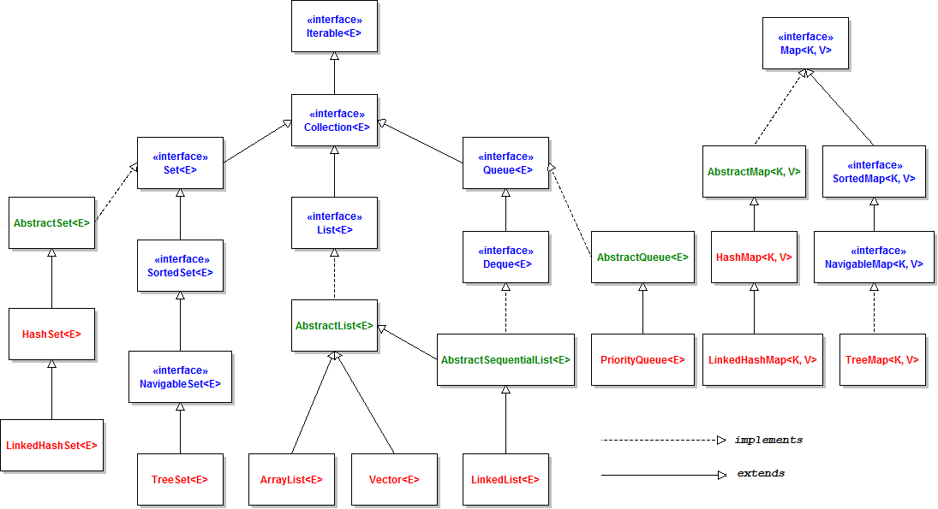
Overview of the Java Collections Framework
Notes:
From:
http://www.codejava.net/java-core/collections/overview-of-java-collections-framework-api-uml-diagram

Slide 4
The general purpose implementations are summarized in the following table (Java 8):
Interface | Hash Table | Resizable Array | Balanced Tree | Linked List | Hash Table + Linked List
Set | HashSet |  | TreeSet |  | LinkedHashSet
List |  | ArrayList |  | LinkedList
Deque |  | ArrayDeque |  | LinkedList
Map | HashMap |  | TreeMap |  | LinkedHashMap
Notes:
From:
https://docs.oracle.com/javase/8/docs/technotes/guides/collections/overview.html

Slide 5

Lists and Sets
Ordered Lists
ArrayList
Stores a list of items in a dynamically sized array
LinkedList
Allows speedy insertion and removal of items from the list
A list is a collection that maintains the order of its elements.
Copyright © 2013 by John Wiley & Sons. All rights reserved.
Page 5

Slide 6
Linked List
LinkedList is a doubly linked list
Node stores two links:
One to the next element, and
One to the previous element
LinkedList has two references :
first (or head) to first element
last to last element

Slide 7
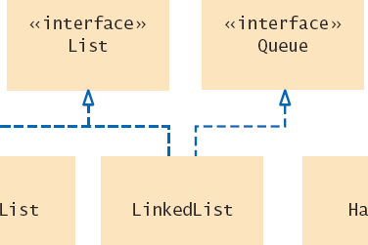
15.2 Linked Lists
Linked lists use references to maintain an ordered lists of ‘nodes’
The ‘head’ of the list references the first node
Each node has a value and a reference to the next node
They can be used to implement
A List Interface
A Queue Interface
Copyright © 2013 by John Wiley & Sons. All rights reserved.
Page 7

Slide 8
Linked Lists Operations
Efficient Operations
Insertion of a node
Find the elements it goes between
Remap the references
Removal of a node
Find the element to remove
Remap neighbor’s references
Visiting all elements in order
Inefficient Operations
Random access
Copyright © 2013 by John Wiley & Sons. All rights reserved.
Page 8

Slide 9
Java's LinkedList class
Generic class
Specify type of elements in angle brackets: LinkedList<Product>
Package: java.util
Easy access to first and last elements with methods void addFirst(E obj) void addLast(E obj) E getFirst() E getLast() E removeFirst() E removeLast()

Slide 10
List Iterator
ListIterator type
Gives access to elements inside a linked list
Encapsulates a position anywhere inside the linked list
Protects the linked list while giving access

Slide 11



Using Iterators
Think of an iterator as pointing between two elements
ListIterator<String> iter = myList.listIterator()
iterator.next();
Note that the generic type for the listIterator must match the generic type of the LinkedList
iterator.add(“J”);
Copyright © 2013 by John Wiley & Sons. All rights reserved.
Page 11

Slide 12
List Iterator
Think of an iterator as pointing between two elements
Analogy: like the cursor in a word processor points between two characters
The listIterator method of the LinkedList class gets a list iterator LinkedList<String> employeeNames = . . .; ListIterator<String> iterator = employeeNames.listIterator();

Slide 13
List Iterator
Initially, the iterator points before the first element
The next method moves the iterator iterator.next();
next throws a NoSuchElementException if you are already past the end of the list
hasNext returns true if there is a next element if (iterator.hasNext()) iterator.next();

Slide 14
List Iterator
The next method returns the element that the iterator is passing while iterator.hasNext() { String name = iterator.next(); Do something with name }
Shorthand: for (String name : employeeNames) { Do something with name } Behind the scenes, the for loop uses an iterator to visit all list elements

Slide 15
List Iterator
LinkedList is a doubly linked list
Node stores two links:
One to the next element, and
One to the previous element
LinkedList has two references :
One to first element
One to last element
To move the list position backwards, use:
hasPrevious
previous

Slide 16
Adding and Removing from a LinkedList
The add method:
Adds an object after the iterator
Moves the iterator position past the new element
iterator.add("Juliet");

Slide 17
Adding and Removing from a LinkedList
The remove method
Removes and
Returns the object that was returned by the last call to next or previous
//Remove all names that fulfill a certain condition while (iterator.hasNext()) { String name = iterator.next(); if (name fulfills condition) iterator.remove(); }
Be careful when calling remove:
It can be called only once after calling next or previous
You cannot call it immediately after a call to add
If you call it improperly, it throws an IllegalStateException

Slide 18
Sample Program
ListTester is a sample program that
Inserts strings into a list
Iterates through the list, adding and removing elements
Prints the list

Slide 19
ListTester.java
01: import java.util.LinkedList;
02: import java.util.ListIterator;
03:
04: /**
05: A program that tests the LinkedList class
06: */
07: public class ListTester
08: {
09: public static void main(String[] args)
10: {
11: LinkedList<String> staff = new LinkedList<String>();
12: staff.addLast("Diana");
13: staff.addLast("Harry");
14: staff.addLast("Romeo");
15: staff.addLast("Tom");
16:
17: // | in the comments indicates the iterator position
18:
19: ListIterator<String> iterator
20: = staff.listIterator(); // |DHRT
21: iterator.next(); // D|HRT
22: iterator.next(); // DH|RT
Continued

Slide 20
ListTester.java (cont.)
23:
24: // Add more elements after second element
25:
26: iterator.add("Juliet"); // DHJ|RT
27: iterator.add("Nina"); // DHJN|RT
28:
29: iterator.next(); // DHJNR|T
30:
31: // Remove last traversed element
32:
33: iterator.remove(); // DHJN|T
34:
35: // Print all elements
36:
37: for (String name : staff)
38: System.out.print(iterator.next() + " ");
39: System.out.println();
40: System.out.println("Expected: Diana Harry Juliet Nina Tom");
41: }
42: }

Slide 21
Self Check
Do linked lists take more storage space than arrays of the same size?
Why don't we need iterators with arrays?
Notes:
Answer: Yes, for two reasons. You need to store the node references, and each node is a separate object. (There is a fixed overhead to store each object in the virtual machine.)
Answer: An integer index can be used to access any array location.

